Slide 1
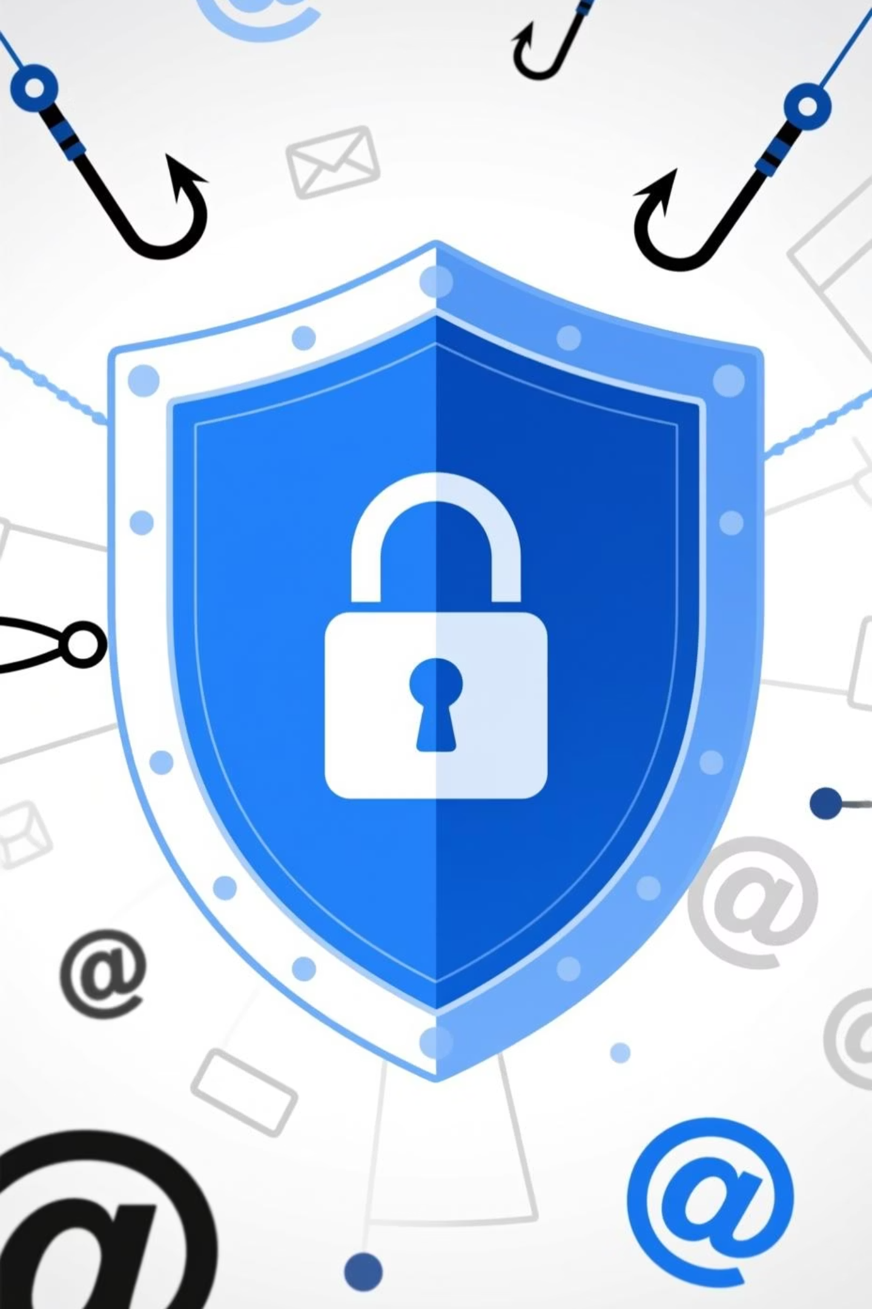
Phishing Awareness Training
Internship Project
Mustafa Muhammad Iqbal

Slide 2



Training Objectives
Understand Phishing
Recognise Threats
Protect Yourself
Learn what phishing is and its common forms.
Develop skills to identify phishing attempts.
Implement best practices to avoid falling victim.

Slide 3
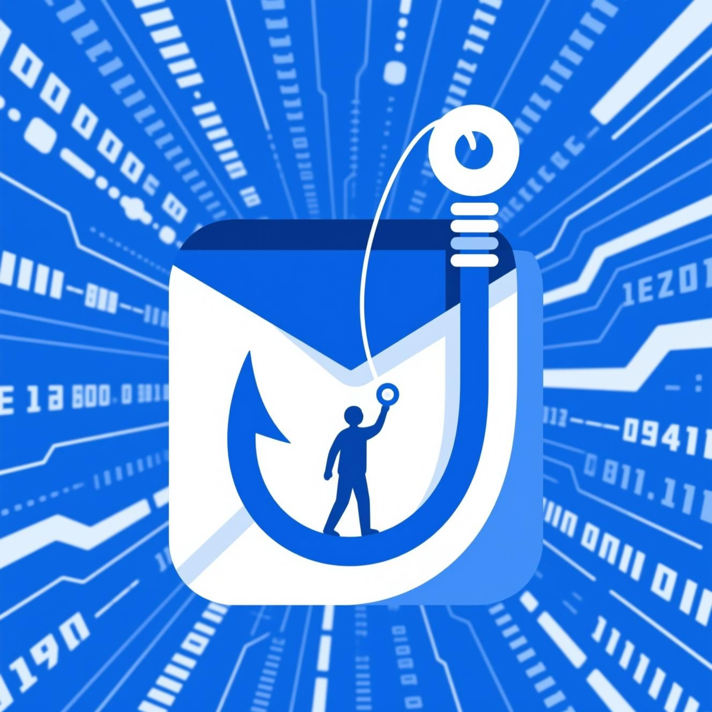
What is Phishing?
Phishing is a type of cyber-attack where criminals attempt to trick individuals into revealing sensitive information, such as passwords, banking details, or other personal data.
They often do this by disguising themselves as a trustworthy entity in electronic communication.

Slide 4




Why It Matters: The Impact of Phishing
Data Breaches
Financial Loss
Compromised personal and organisational data.
Direct monetary theft from individuals or companies.
Identity Theft
Reputation Damage
Personal information used for fraudulent activities.
Loss of trust and credibility for affected organisations.

Slide 5
Recognising Phishing Emails: Red Flags
Suspicious Sender
Urgency & Threats
Unexpected Attachments
Email addresses that don't match the purported sender.
Demands for immediate action or threats of account closure.
Unsolicited files, especially executables (.exe) or compressed (.zip).
Spelling & Grammar Errors
Mismatched URLs
Hyperlinks that lead to different addresses than displayed.
Numerous mistakes indicate a lack of professionalism.

Slide 6
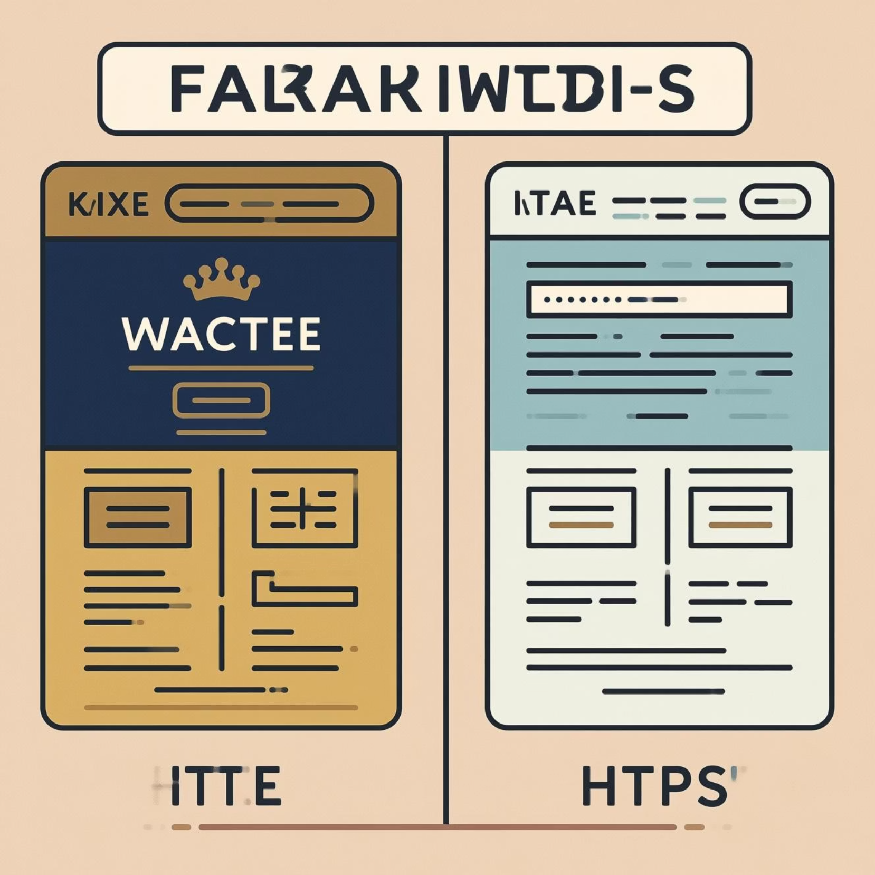
Identifying Fake Websites
Check the URL: Look for slight misspellings or unusual domain extensions.
HTTPS & Lock Icon: Ensure the website uses HTTPS and has a padlock icon, but note this alone isn't foolproof.
Poor Design: Low-quality images, inconsistent branding, or odd layouts.
Pop-up Overload: Excessive or suspicious pop-up windows.

Slide 7




Social Engineering Tactics
Authority
Urgency
Impersonating superiors, IT support, or law enforcement.
Creating a false sense of haste to bypass critical thinking.
Fear
Temptation
Threatening negative consequences if demands aren't met.
Offering alluring deals, prizes, or exclusive access.

Slide 8
Best Practices: Do's and Don'ts
DO'S
DON'TS
Hover Before Clicking: Check the real URL of a link without clicking it.
Don't Click Unverified Links: Especially from unknown or suspicious senders.
Use Multi-Factor Authentication (MFA): Adds an extra layer of security.
Don't Download Unknown Attachments: They can contain malware.
Report Suspicious Emails: Forward to your IT security team immediately.
Don't Reply to Suspicious Emails: This confirms your email is active.
Verify Information: Independently confirm requests via official channels (e.g., call the sender).
Don't Share Personal Information: Never give out passwords or sensitive data via email.

Slide 9

Real-World Examples
Google Docs Scam (2017)
COVID-19 Phishing (2020-Present)
Banking Scams
Emails mimicking major banks, alerting users to "unusual activity" or "account suspension," directing them to fake login pages to steal credentials.
A widespread phishing campaign that sent emails appearing to be from legitimate contacts, asking users to open a Google Docs file, which then requested access to their Google account.
Cybercriminals exploited pandemic fears, sending emails disguised as health organisations (e.g., WHO, NHS) offering fake cures, grants, or updates, often leading to malware or credential theft.

Slide 10

Key Takeaway: Think Before You Click!
Your vigilance is the best defence against phishing attacks.

